Slide 1
BIOC4966
Biochemistry Internship
Oral Presentation
by Rho Yerim

Slide 2
1. Internship Project Details
Table of Contents
2. Link to Science & Society
3. Opportunities for problem-solving
4. Personal Reflection

Slide 3

1
Internship Project Details
Cancer Genomics Laboratory
Supervisor: Dr Wong, Jason Wing Hon

Slide 4
Project Details
Research Project: LINE-1 type transposase domain containing 1 (L1TD1) gene expression in Colorectal Adenomas
1
Bulk RNA-sequencing
4
Single Cell RNA-sequencing (scRNA-seq)
2
Differential Gene Expression (DGE) Analysis
5
Gene set Enrichment Analysis (GSEA)
3
Motif Analysis
6
DNA methylation Analysis

Slide 5
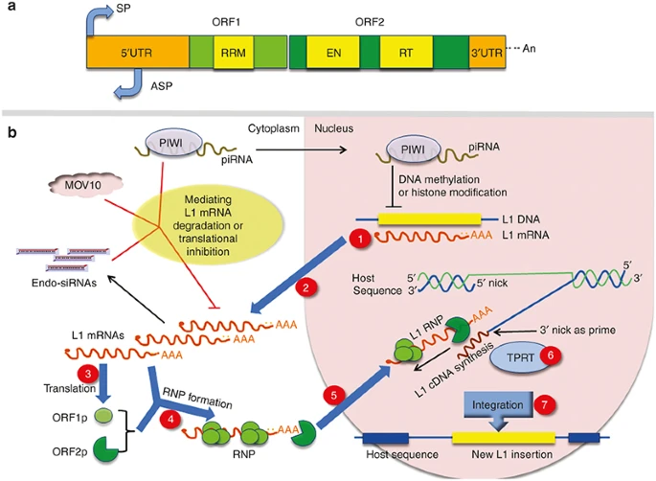
Project Details
LINE-1 type transposase domain containing 1 (L1TD1)
L1TD1
Contains a domain similar to the transposase domain of LINE-1 elements.
LINE-1: Type of Transposable Element
Transposase domain responsible for movement of transposable elements (TEs) within a genome.
Figure 1. Structure of a full-length LINE-1
Xiao-Jie, L., Hui-Ying, X., Qi, X. et al. (2016). LINE-1 in cancer: multifaceted functions and potential clinical implications. Genet Med 18, 431–439. https://doi.org/10.1038/gim.2015.119

Slide 6
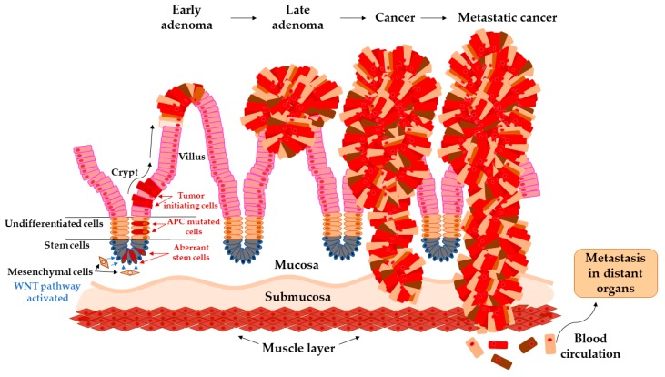
Project Details
Development of Colorectal Cancer (CRC)
Figure 2. Transition of early adenoma to metastatic cancer.
Siskova, A., Cervena, K., Kral, J.et al. (2020). Colorectal Adenomas-Genetics and Searching for New Molecular Screening Biomarkers. International journal of molecular sciences, 21(9), 3260. https://doi.org/10.3390/ijms21093260

Slide 7
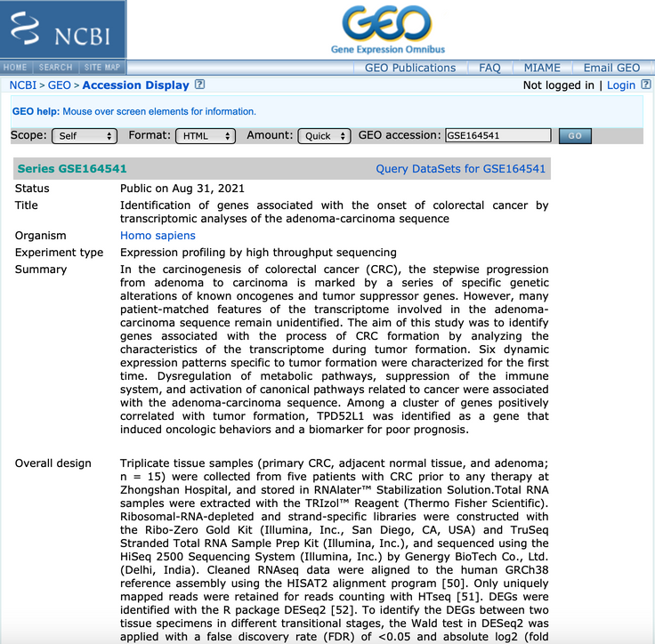
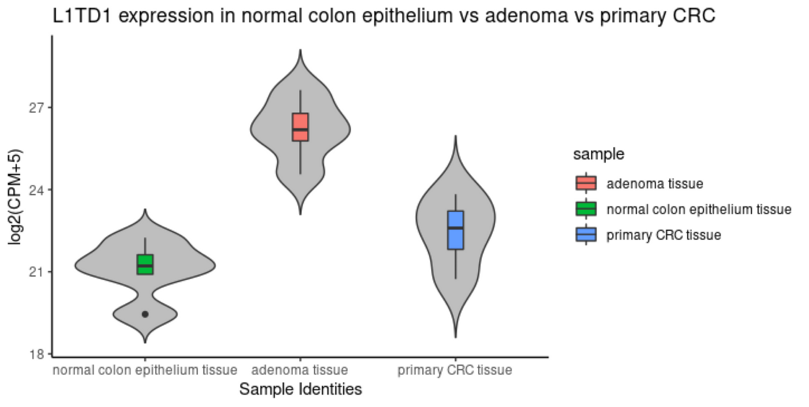
Project Details
L1TD1 expression in Normal colon vs Adenoma vs Primary Colorectal Cancer (CRC)
Bulk RNA-seqencing
Adenoma
Figure 4. Gene Expression Omnibus (GEO) website of Bulk RNA-seq Dataset (GEO Accession GSE164541)
Figure 3. Violin plot of L1TD1 gene expression
Triplicate tissue samples
5 primary CRC
5 adjacent normal tissue
5 adenoma

Slide 8
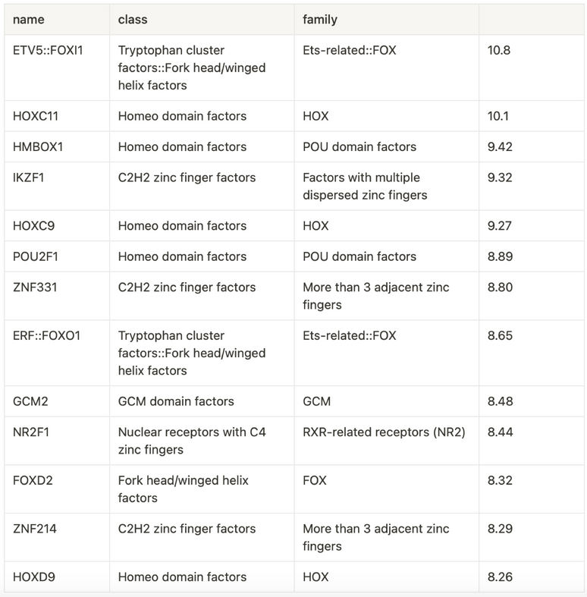
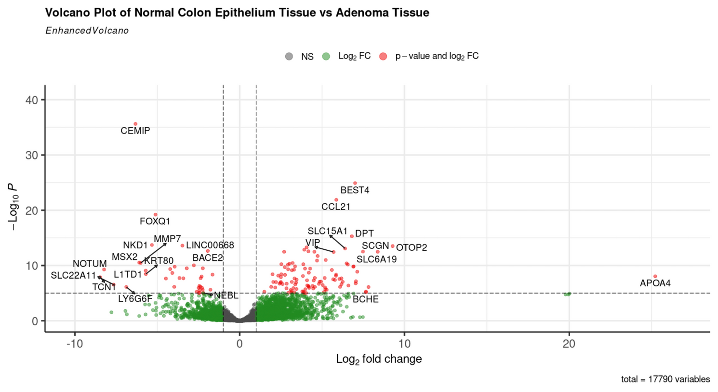
Project Details
Key Point 1
The binding of specific transcription factors (TFs) to the L1TD1 gene during adenoma stages may activate the expression level of the L1TD1 gene.
Differential Gene Expression Analysis
Motif Analysis
Figure 5. Volcano Plot of Normal Colon vs Adenoma Tissue
Table 1. Top motifs in L1TD1 promoter (TSS +/- 200bp)
To identify differentially expressed genes only in adenoma tissue
To determine which transcription factors (TF) bind to the L1TD1 promoter

Slide 9
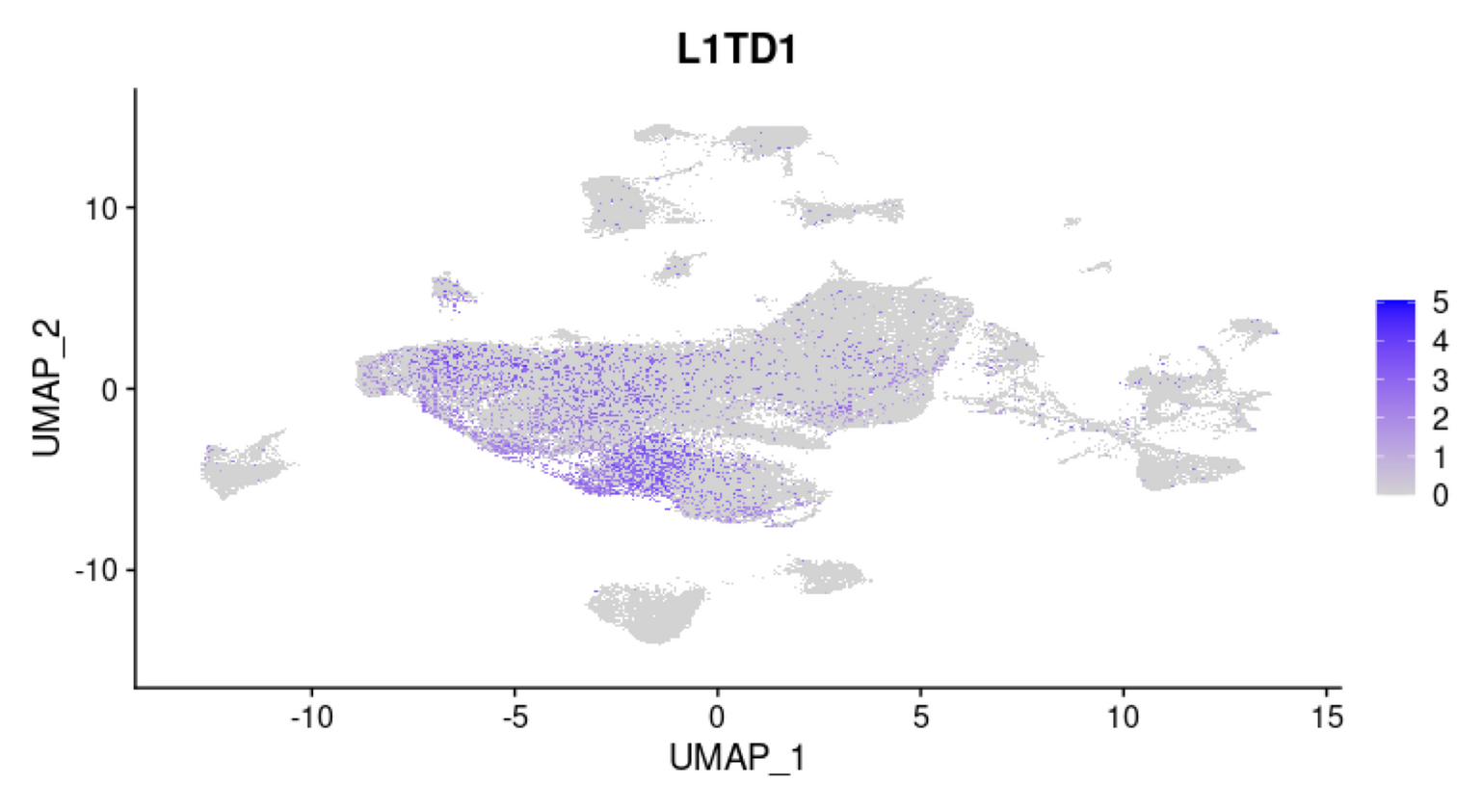
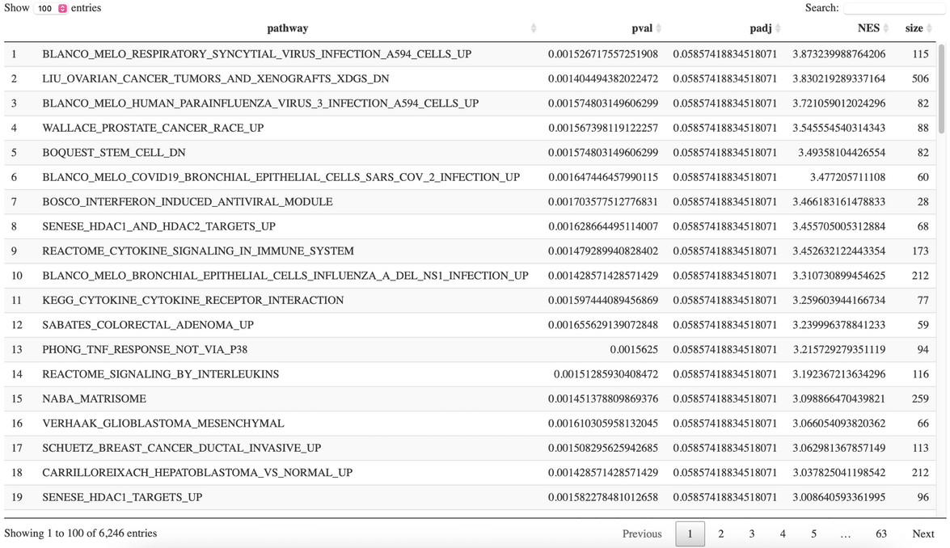
Project Details
Key Point 2
Identifying specific cell populations of L1TD1 gene and its potential linkage to distinct biological pathways.
Single Cell RNA-sequencing
Gene set Enrichment Analysis (GSEA)
Figure 6. UMAP representation of L1TD1 gene expressed in single cell analysis
Table 2. Pathways ordered by normalized enrichment score (NES)
To visualize which cell populations of L1TD1 genes are highly expressed
To interpret the biological pathways associated with high expression of L1TD1

Slide 10
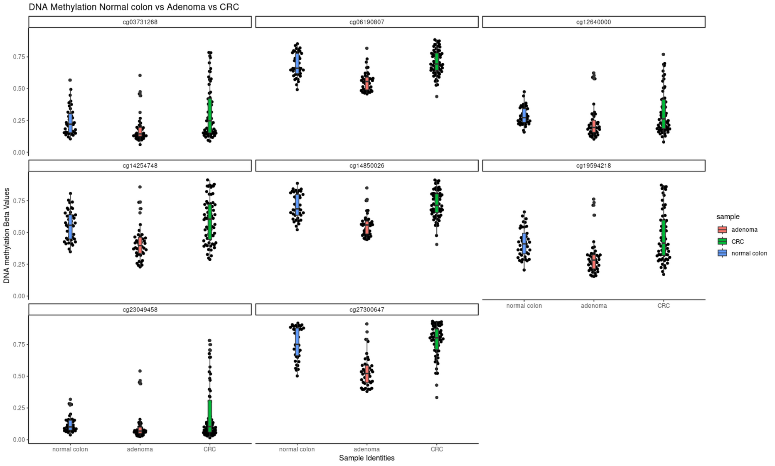
Project Details
Key Point 3
DNA methylation may be regulating the high gene expression level of L1TD1 in adenoma.
DNA methylation Analysis
Figure 7. DNA methylation Beta Values on L1TD1 sites for each probe
To evaluate DNA methylation patterns at L1TD1 sites across normal, adenoma, and CRC.

Slide 11
Project Details
Overview of Analysis
Bulk RNA-sequencing
Motif Analysis
Gene set Enrichment Analysis (GSEA)
To determine L1TD1 gene expression across distinct cell stages to understand expression patterns
To determine which transcription factors (TF) bind to the L1TD1 promoter
To interpret the biological pathways associated with high expression of L1TD1
Differential Gene Expression Analysis
Single cell RNA-sequencing
DNA methylation Analysis
To identify differentially expressed genes only in adenoma tissue
To visualize which cell populations of L1TD1 genes are highly expressed
To evaluate DNA methylation patterns at L1TD1 sites across normal, adenoma, and CRC

Slide 12
2
Link to Science & Society

Slide 13

2. Link to Science & Society
Cancer genomics
Scientific Insights
Understand genomic alterations associated with cancer development.
Analyzing gene expression across different cell stages
→ valuable insights into the molecular changes during the cancer progression.
Link to Society
Cancer = one of the most common and severe diseases.
Potential of changing the way of diagnosing and treating the patients.
Lead to societal well-being.
Macconaill, L. E., & Garraway, L. A. (2010). Clinical implications of the cancer genome. Journal of clinical oncology : official journal of the American Society of Clinical Oncology, 28(35), 5219–5228. https://doi.org/10.1200/JCO.2009.27.4944

Slide 14
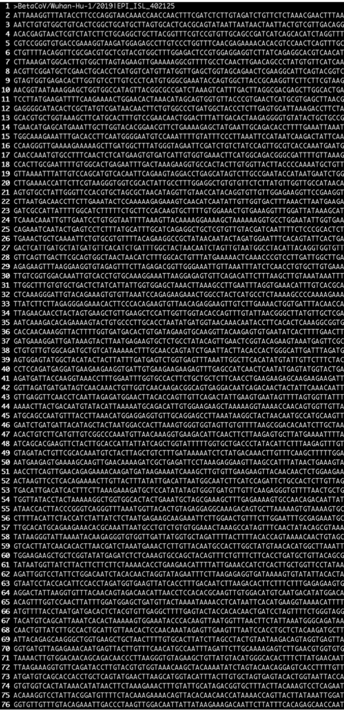
2. Link to Science & Society
Bioinformatics
Analyze biological data, particularly at the molecular level that enables to extract meaningful insights from big data.
Biology
Statistics
Computer
Science
Figure 8. An example fasta file showing the first part
Time-efficient & Discern useful information
Luscombe, Nicholas & Greenbaum, Dov & Gerstein, Mark. (2000). What is bioinformatics? An introduction and overview. Yearbook of Medical Informatics. 10. 10.1055/s-0038-1638103.

Slide 15
2. Link to Science & Society
Ethical Issue for Society
Academic research can suggest clinical approaches to the genes of cancer patients, but when applying to clinical stages it may raise controversial ethical issues for society.

Slide 16
3
Opportunities for Problem-Solving

Slide 17
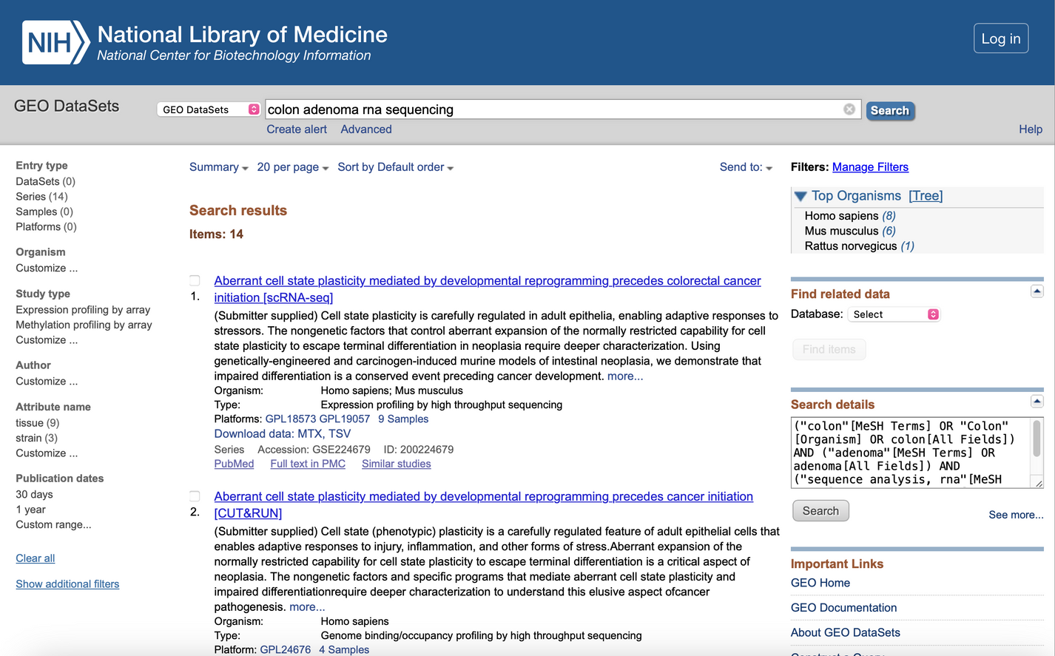


3. Opportunities for Problem-Solving
Problem: Vast pool of available big data
Figure 9. List of datas in GEO website

Slide 18
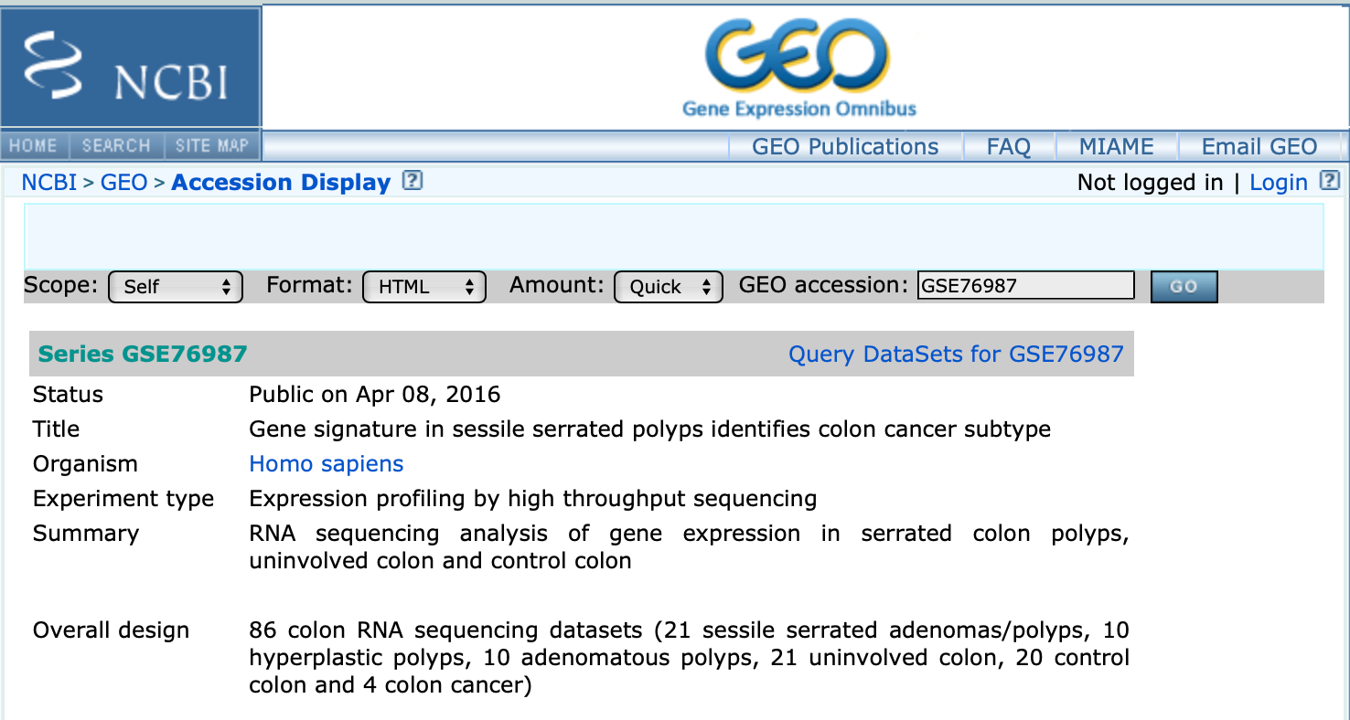
3. Opportunities for Problem-Solving
Solution: Question relevancy of the dataset
Find datasets that has more adenoma samples
Figure 10. GEO website of Bulk RNA-seq Dataset (GEO Accession GSE76987)

Slide 19
4
Personal Reflection

Slide 20


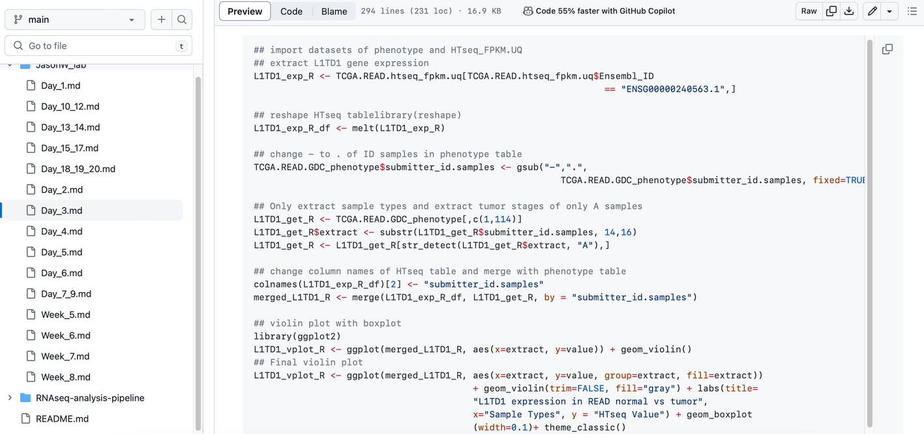
4. Personal Reflection
Organize written records of details
Notion
Github
Written record allowed me to discern patterns by referring back to the past codes.

Slide 21
4. Personal Reflection
Weakness
Rely on the instructions
Found myself preoccupied with completing given tasks
Focus on showcasing my progress and dedication
Future goal
prioritize the development of my creative thinking skills
take ownership of the project
recognize the significant role I play in its success

Slide 22
5
Conclusion

Slide 23
5. Conclusion
Conclusion
Enjoyment in Bioinformatics
Visualizing the outcomes of my analyses and independently constructing code.
Mindset of curiosity
Continue to ask questions rather than provide answers.
Recognize the importance of continuously enhancing my knowledge rather than focusing on teaching others.

Slide 24
REFERENCES
1.
Luscombe, Nicholas & Greenbaum, Dov & Gerstein, Mark. (2000). What is bioinformatics? An introduction and overview. Yearbook of Medical Informatics. 10. 10.1055/s-0038-1638103.
2.
Macconaill, L. E., & Garraway, L. A. (2010). Clinical implications of the cancer genome. Journal of clinical oncology : official journal of the American Society of Clinical Oncology, 28(35), 5219–5228. https://doi.org/10.1200/JCO.2009.27.4944
3.
Siskova, A., Cervena, K., Kral, J.et al. (2020). Colorectal Adenomas-Genetics and Searching for New Molecular Screening Biomarkers. International journal of molecular sciences, 21(9), 3260. https://doi.org/10.3390/ijms21093260
4.
Xiao-Jie, L., Hui-Ying, X., Qi, X. et al. (2016). LINE-1 in cancer: multifaceted functions and potential clinical implications. Genet Med 18, 431–439. https://doi.org/10.1038/gim.2015.119
FIGURE REFERENCES
Figure 1
Xiao-Jie, L., Hui-Ying, X., Qi, X. et al. (2016). LINE-1 in cancer: multifaceted functions and potential clinical implications. Genet Med 18, 431–439. https://doi.org/10.1038/gim.2015.119
Figure 2
Siskova, A., Cervena, K., Kral, J.et al. (2020). Colorectal Adenomas-Genetics and Searching for New Molecular Screening Biomarkers. International journal of molecular sciences, 21(9), 3260. https://doi.org/10.3390/ijms21093260

Slide 25
Thank you!

Slide 26
Q & A

